Slide 1
Quick Dashboarding with Python
Alexander Baker

Slide 2


What is Streamlit?
Streamlit is an open source python library that allows users to quickly draft data applications
The main strength of Streamlit is its simple “pythonic” syntax associated with the library
This allows streamlit to fit into machine learning pipelines seamlessly
All one needs to execute a Streamlit dash is to run “streamlit run dash_name.py” from the console of your choice

Slide 3
How Streamlit Works
Streamlit interacts with the user through widgets
Widgets are different methods of inputs
Everytime source code is changed, or a widget is interacted with, Streamlit automatically reruns all the associated python script from top to bottom
Streamlit has a variety of output tools that allows the display of various plots and text
When a folder named “pages” is created, streamlit will automatically include each script in that folder as a page within the dash

Slide 4

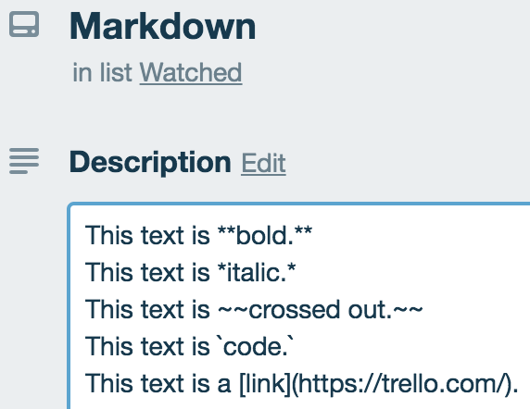
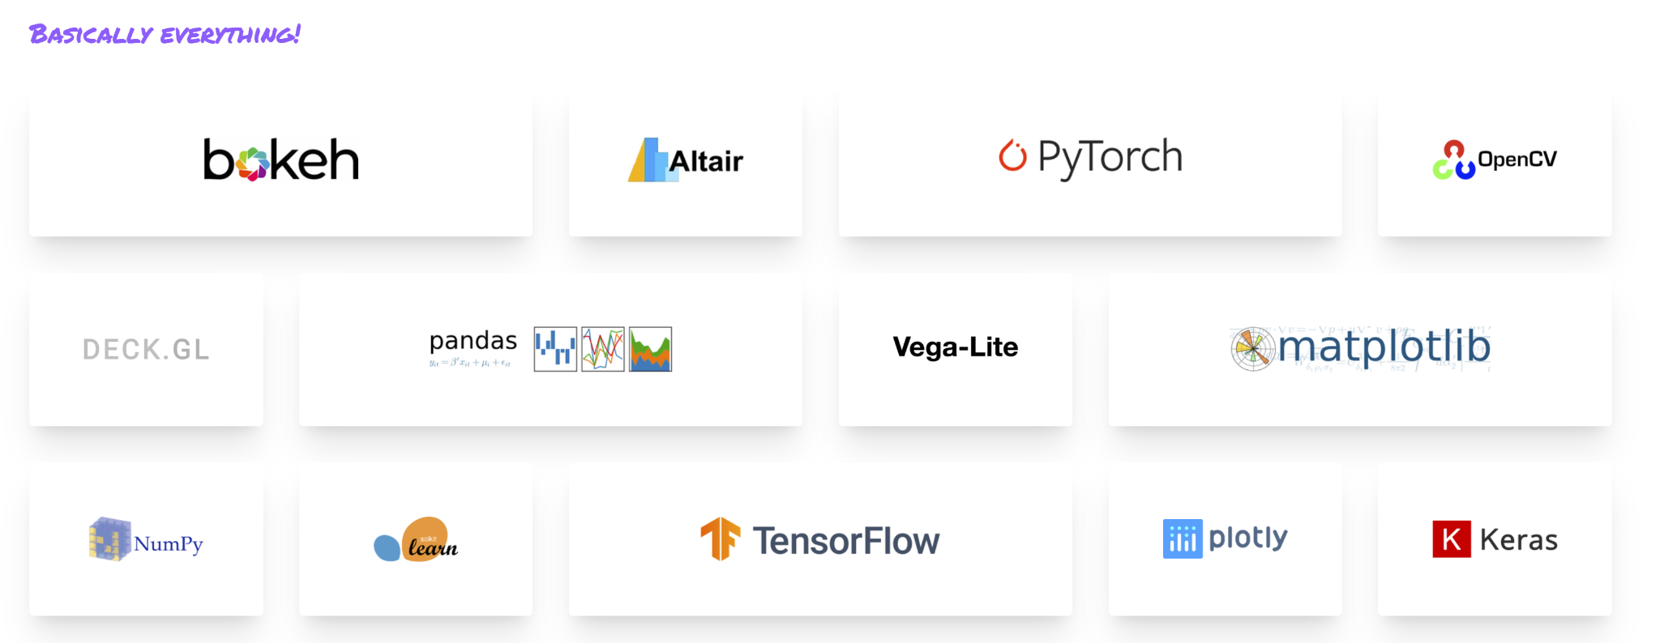
Advantages of Streamlit
Streamlit allows the user to create dashboards only using python scripts
Streamlit is compatible with numerous plotting libraries
Excellent formatting options including markdown and Latex
Streamlit is compatible with HTML, CSS, and Javascript
Pages and column formatting is simple with Streamlit
Streamlit allows for simple integration and deployment of machine learning models
Streamlit allows for seamless updates

Slide 5
Links
My LinkedIn Profile
The Amazing Streamlit Documentation
Follow Illuminate AI

